Slide 1
Chongqing University of Technology
ATAI
Advanced Technique of Artificial Intelligence
Chongqing University of Technology
Structure-Aware Abstractive Conversation Summarization
via Discourse and Action Graphs
Jiaao Chen
School of Interactive Computing
Georgia Institute of Technology
jiaaochen@gatech.edu
Diyi Yang
School of Interactive Computing
Georgia Institute of Technology
dyang888@gatech.edu
ACL_2021
Code : https://github.com/ GT-SALT/Structure-Aware-BART
Reported by Xinsheng Wang
Notes:
Code : https://github.com/ GT-SALT/Structure-Aware-BART

Slide 2
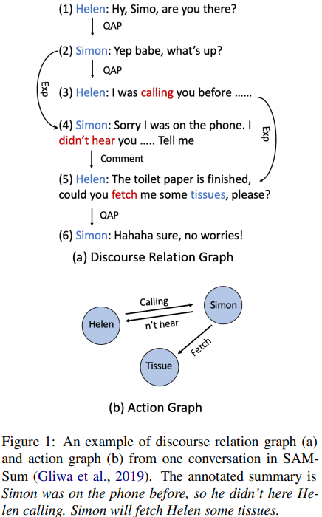
Introduction

Slide 3
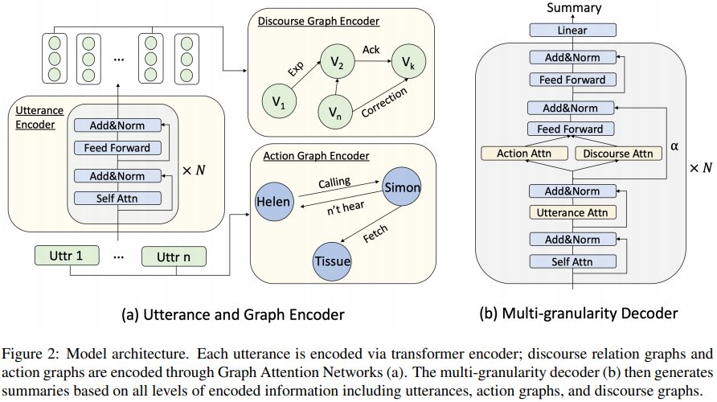
Method
Utterance Encoder
Cite_2020_BART: Denoising Sequence-to-Sequence Pre-training for Natural Language Generation, Translation, and Comprehension

Slide 4
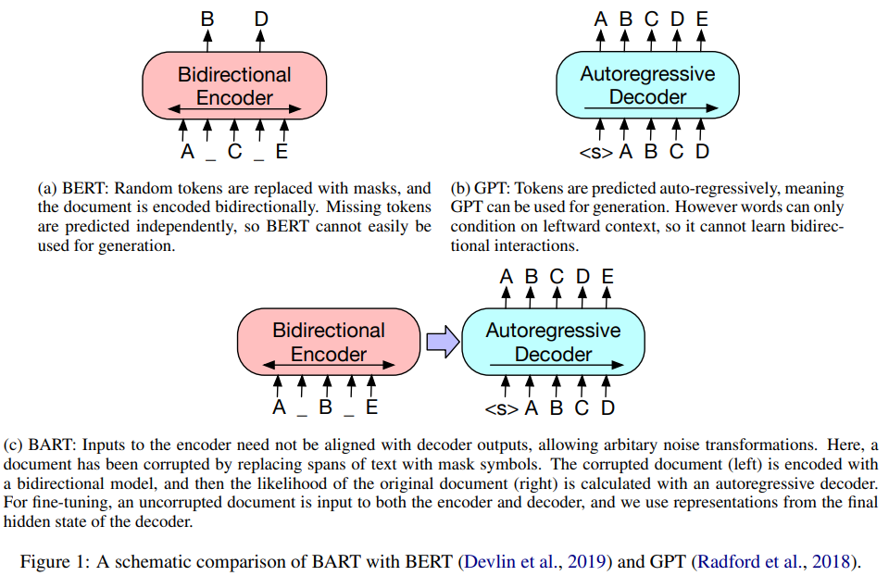
Method
https://www.zhihu.com/search?type=content&q=BART
Cite_2020_BART: Denoising Sequence-to-Sequence Pre-training for Natural Language Generation, Translation, and Comprehension
Notes:
更适合生成任务

Slide 5
Method
Action Graph
cite_2014_The Stanford CoreNLP Natural Language Processing Toolkit
cite_IJCNLP_2015_Leveraging Linguistic Structure For Open Domain Information Extraction
Notes:
输入是一段对话，Uttr n 代表一个句子
构造Action Graph，首先将第一视角的句子形式转化为第三视角的，
转化规则是将句子中的人称代词或者指示代词替换为具体的人名或物品名(stanford CoreNLP coreference来实现)
节点是人名或物品名d
https://qa.1r1g.com/sf/ask/2112749691/

Slide 6
Method
Discource Graph Encoder
Structured Graph Attention Network
cite_AAAI_2019_A Deep Sequential Model for Discourse Parsing on Multi-Party Dialogues
Notes:
Comment (19.3%), Clarification Question (15.2%), Elaboration (2.3%), Acknowledgement(8.4%), Continuation (10.1%), Explanation (2.8%), Conditional (0.2 %), Question Answer Pair (21.5%), Alternation (0.3%), Q-Elab (2.5%), Result (5.5%), Background (0.4%), Narration (0.4%), Correction (0.4%), Parallel (0.9%), and Contrast (1.0%)

Slide 7
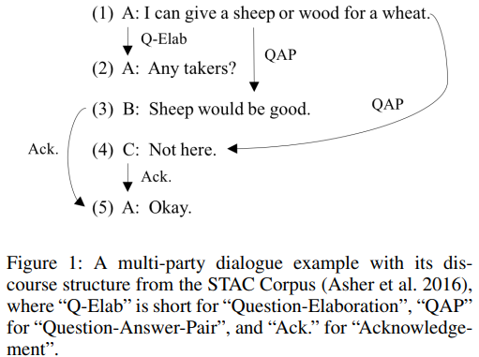
Method
cite_AAAI_2019_A Deep Sequential Model for Discourse Parsing on Multi-Party Dialogues
Notes:
https://zhuanlan.zhihu.com/p/296331236

Slide 8
Method
Multi-Granularity Decoder

Slide 9
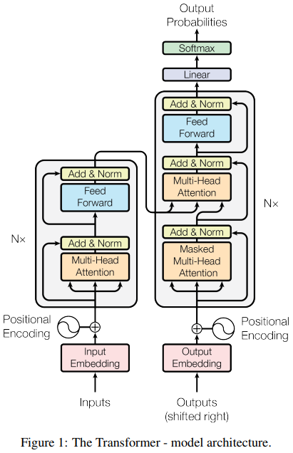
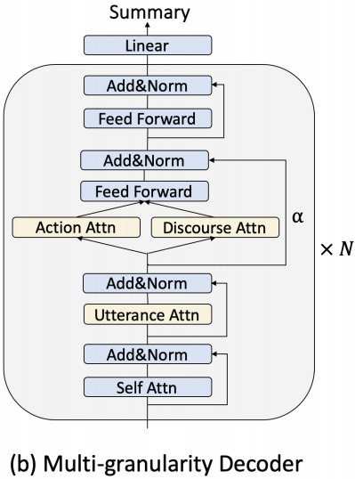
Method
Notes:
Teacher forcing

Slide 10
Experiments

Slide 11
Experiments

Slide 12
Experiments

Slide 13
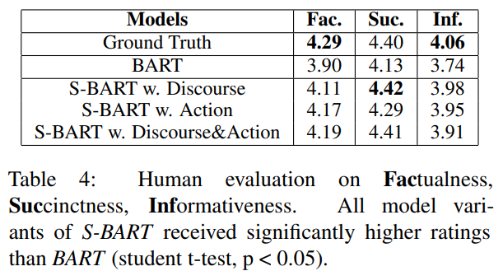
Experiments

Slide 14
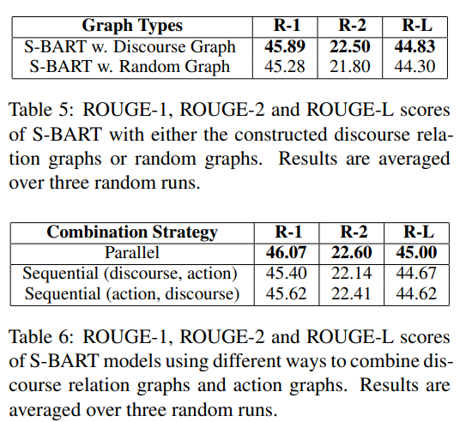
Experiments

Slide 15
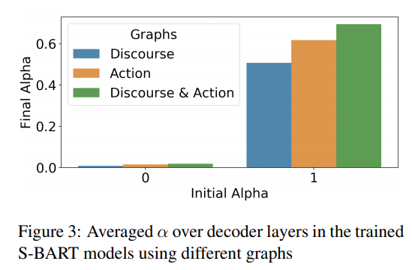
Experiments

Slide 16
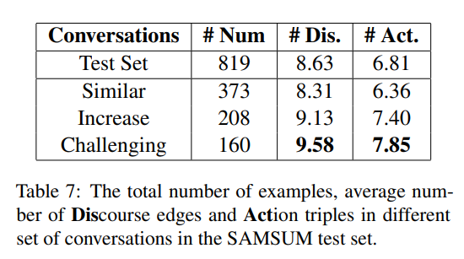
Experiments

Slide 17
Thank you!

